Slide 1
C++
Md. Abdur Rahman
Senior Computer Scientist
Centre for Advanced in Research in Sciences (CARS)
University of Dhaka

Slide 2
Convention for Getters/Setters and Constructors
class Aaa {
private:
// A private variable named i of type T
T i;
public:
// Constructor
Aaa(T x) { i= x; }
// OR
Aaa(T i) { this->i= i; }
// OR using member initializer list (to be explained later)
Aaa(T i) : i (i) { }
// A getter for variable i of type T receives no argument and return a value of type T
T getI() const { return i; }
// A setter for variable i of type T receives a parameter of type T and return void
void setI(T x) { i = x; }
// OR
void setI(T i) { this->I = i; }
}

Slide 3
Member Initializer List
C++ provide an alternative syntax to initialize data members in the constructor called member initializer list.
class Account {
private:
int accountNumber;
double balance;
Account(int no, double b=0.0)
};
Account::Account(int no, double b) : accountNumber(no), balance(b) {
// The body runs after the member initializer list
// empty in this case
}

Slide 4
Polymorphism
Polymorphism means having multiple forms of one thing.
Polymorphism is mainly divided into two types:
Compile time Polymorphism
This type of polymorphism is achieved by function overloading or operator overloading.
Runtime Polymorphism
This type of polymorphism is achieved by Function Overriding.

Slide 5
Function Overloading
When there are multiple functions with same name but different parameters then these functions are said to be overloaded. Functions can be overloaded by change in number of arguments or/and change in type of arguments.
Check example.

Slide 6
Operator overloading
In C++, it's possible to change the way operator works (for user-defined types).
The feature in C++ programming that allows programmer to redefine the meaning of an operator (when they operate on class objects) is known as operator overloading.

Slide 7
Operator overloading
Things to remember:
Operator overloading allows you to redefine the way operator works for user-defined types only (objects, structures). It cannot be used for built-in types (int, float, char etc.).
Two operators = and & are already overloaded by default in C++. For example: To copy objects of same class, you can directly use = operator. You do not need to create an operator function.

Slide 8
Operator overloading
Things to remember:
Operator overloading cannot change the precedence and associatively of operators. However, if you want to change the order of evaluation, parenthesis should be used.
There are 4 operators that cannot be overloaded in C++. They are :: (scope resolution), . (member selection), .* (member selection through pointer to function) and ?:(ternary operator).

Slide 9
Function Overriding
If we inherit a class into the derived class and provide a definition for one of the base class's function again inside the derived class, then that function is said to be overridden, and this mechanism is called Function Overriding

Slide 10
Requirements for Overriding
Inheritance should be there. Function overriding cannot be done within a class. For this we require a derived class and a base class.
Function that is redefined must have exactly the same declaration in both base and derived class, that means same name, same return type and same parameter list.

Slide 11
Function Overloading VS Function Overriding
Inheritance: Overriding of functions occurs when one class is inherited from another class. Overloading can occur without inheritance.
Function Signature: Overloaded functions must differ in function signature ie either number of parameters or type of parameters should differ. In overriding, function signatures must be same.
Scope of functions: Overridden functions are in different scopes; whereas overloaded functions are in same scope.
Behavior of functions: Overriding is needed when derived class function has to do some added or different job than the base class function. Overloading is used to have same name functions which behave differently depending upon parameters passed to them.

Slide 12
Object Pointer
Object members are accessed by dot operator. However, it is also possible to access a member of an object via a pointer to that object. When a pointer is used, the arrow operator (->) rather than the dot operator is used.

Slide 13
Example: The Account Class
A class called Account, which models a bank account, is designed as shown in the class diagram. It contains:
Two private data members: accountNumber (int) and balance (double), which maintains the current account balance.
Public functions credit() and debit(), which adds or subtracts the given amount from the balance, respectively. The debit() function shall print "amount withdrawn exceeds the current balance!" if amount is more than balance.
A public function print(), which shall print "A/C no: xxx Balance=xxx" (e.g., A/C no: 991234 Balance=$88.88), with balance rounded to two decimal places.

Slide 14
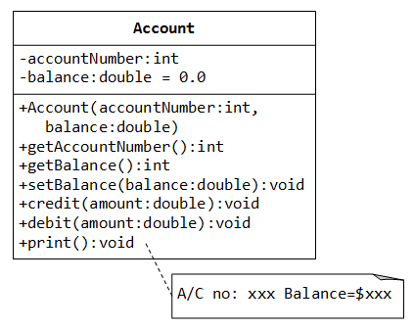
Example: The Account Class

